Slide 1
UNIT - III
Coding Standards – Framework – Reviews – Types of Review - DeskChecks- Walkthroughs-Inspection- Code review-Automatic Code Generation - Pair Programming – Software reuse-TDD – Software construction artifacts

Slide 2
Coding Standards
A coding standard gives a uniform appearance to the codes written by different engineers.
It improves readability, and maintainability of the code and it reduces complexity also.
It helps in code reuse and helps to detect error easily.
It promotes sound programming practices and increases efficiency of the programmers.

Slide 3
Guidelines
Limited use of global:
Standard headers for different modules:
Naming conventions for local variables, global variables, constants and functions
Indentation:
Error return values and exception handling conventions
Avoid using an identifier for multiple purposes:
Code should be well documented:
Length of functions should not be very large
Try not to use GOTO statement:
Avoid using a coding style that is too difficult to understand:

Slide 4
Coding Framework
For software construction, a coding framework is needed that will ensure a consistent coding production with standard code that will be easy to debug and test .
In object oriented programming, what base classes are to be made, which will be used throughout construction, is a subject that is part of the coding framework.
In general, coding frameworks allow construction of the common infrastructure of basic functionality which can be extended later by the developers.
Benefits: Increases productivity ,
Allows for a robust and
Well structured software product.

Slide 5
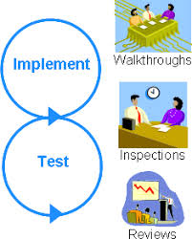
REVIEW TECHNIQUES

Slide 6
Reviews (Quality Control)
Almost 70% of software defects arise from faulty software code.
To solve this problem, software construction is the most labor intensive phase in software development.
Any construction rework means wasting a lot of effort already put in.
Moreover, it is also a fact that it is cheaper to fix any defects found during construction at the phase level itself.
If those defects are allowed to go in software testing , then fixing those defects will become costlier .
That is why review of the software code and fixing defects is very important.

Slide 7
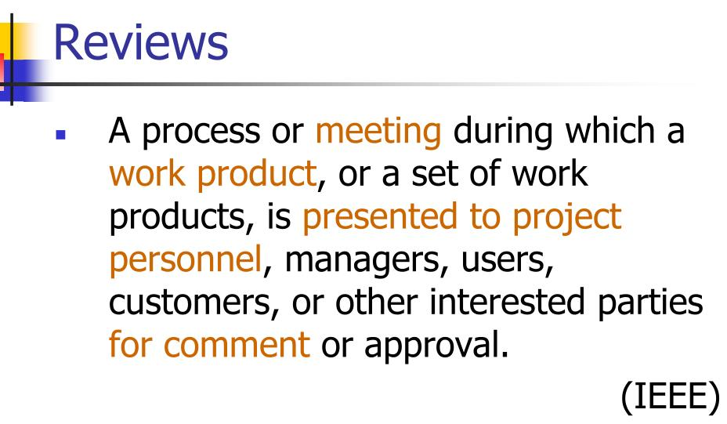

Slide 8
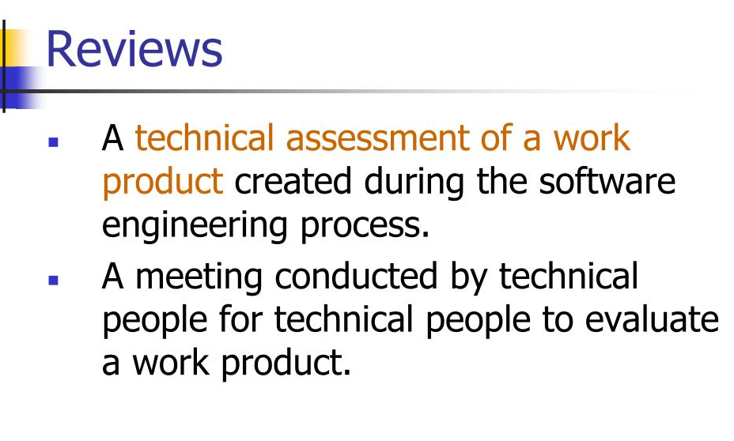

Slide 9
Review – two definitions
A formal, scheduled activity where a designer presents material about a design and a selected group of peers evaluates the technical aspects of the design.
The inclusive name for reviews, walkthroughs, and inspections
Notes:
3

Slide 10
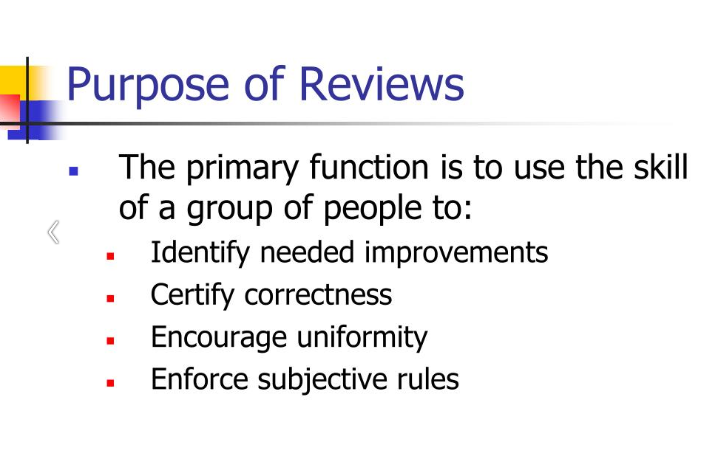

Slide 11
Types of Review
There are some techniques available
Deskchecks
Buddy Checking
walkthroughs
code reviews
inspections
etc. that ensure quality of the written code.

Slide 12
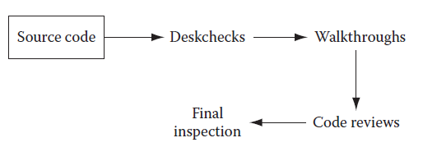
Source code review methods and their operation sequence

Slide 13
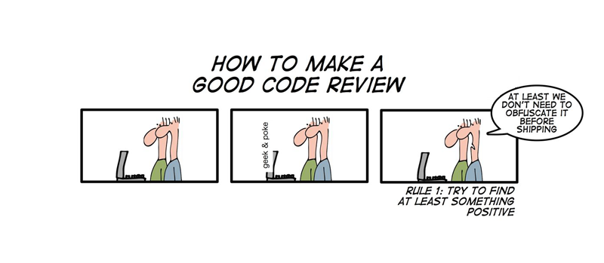
Deskchecks (Peer Reviews)
Deskchecks are employed when a complete review of the source code is not important.
Here, the developer sends his piece of code to the designated team members.
These team members review the code and send feedback and comments to the developer as suggestions for improvement in the code.
The developer reads those feedbacks and may decide to incorporate or to discard those suggestions.
So this form of review is totally voluntary.
Still, it is a powerful tool to eliminate defects or improve software code.

Slide 14
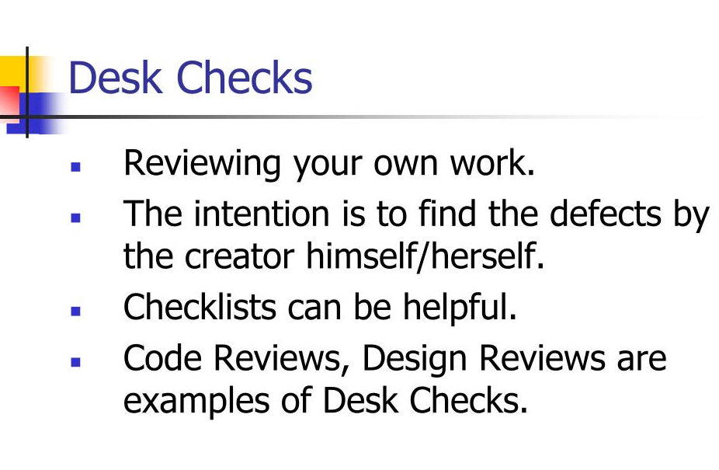

Slide 15
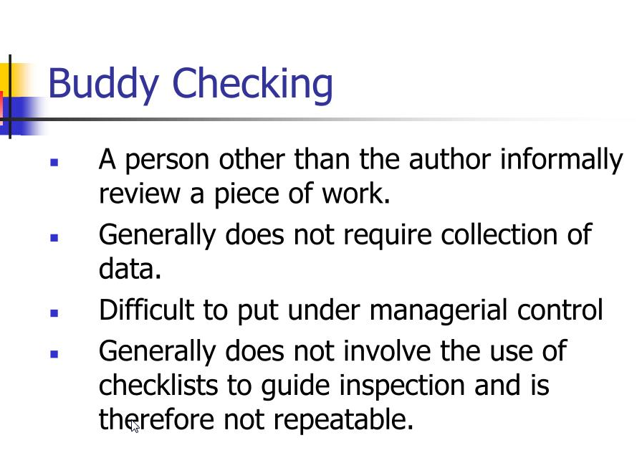

Slide 16
Types of Review: Walkthroughs
A walkthrough is an informal way of presenting a technical document in a meeting.
Unlike other kinds of reviews, the author runs the walkthrough: calling the meeting, inviting the reviewers, soliciting comments and ensuring that everyone present understands the work product.
Walkthroughs are used when the author of a work product needs to take into account the perspective of someone who does not have the technical expertise to review the document.
After the meeting, the author should follow up with individual attendees who may have had additional information or insights. The document should then be corrected to reflect any issues that were raised.

Slide 17
Types of Review: Walkthroughs
Guidelines for a Successful Walkthrough
Verify that everyone is present who needs to review the work. This can include users, stakeholders, engineering leads, managers and other interested people.
Verify that everyone present understands the purpose of the walkthrough meeting and how the material is going to be presented.
Describe each section of the material to be covered by the walkthrough.
Present the material in each section, ensure that everyone present understands the material.
Lead a discussion to identify any missing sections or material.
Document all issues that are raised by walkthrough attendees.

Slide 18
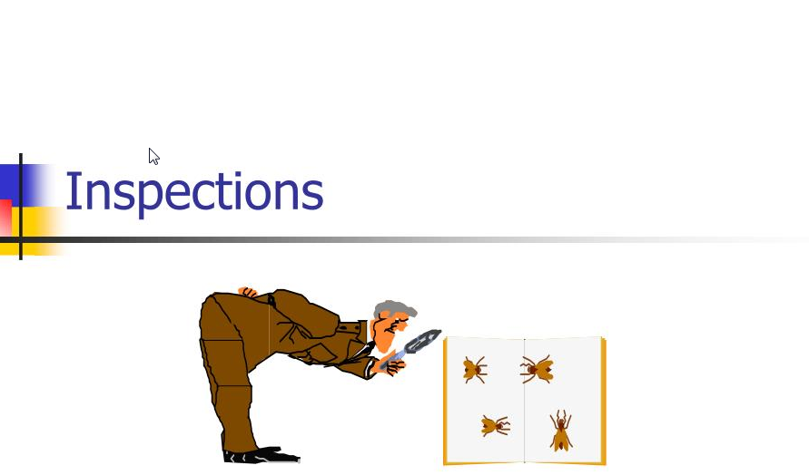

Slide 19
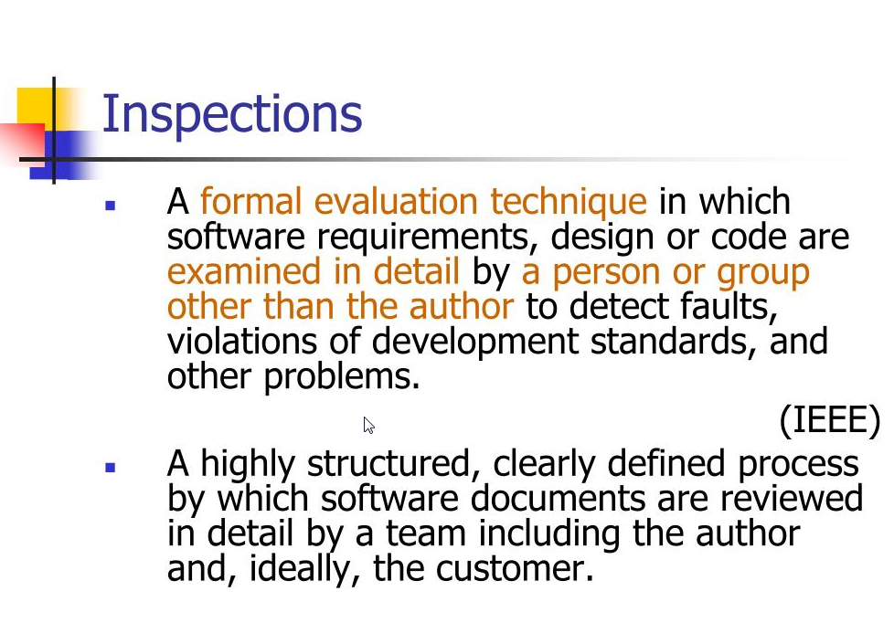

Slide 20
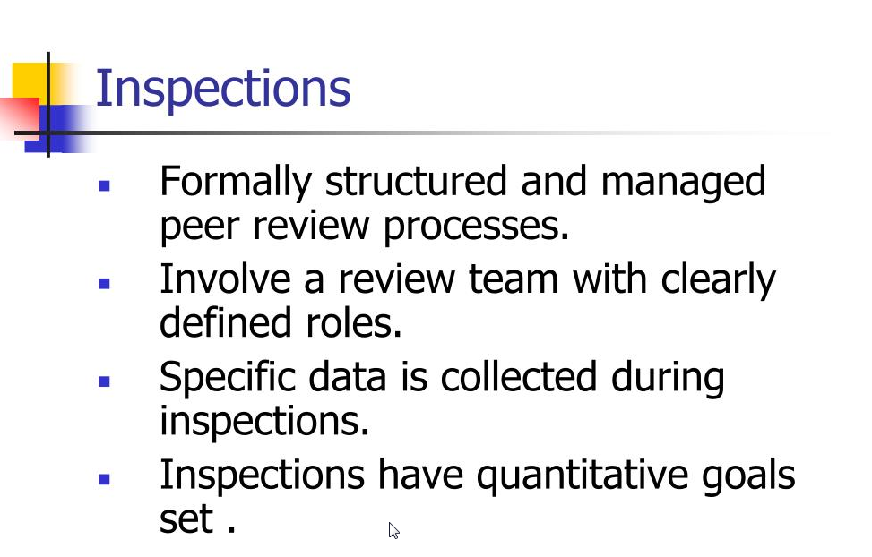

Slide 21
Code Review
A code review is a special kind of inspection in which the team examines a sample of code and fixes any defects in it.
In a code review, a defect is a block of code which does not properly implement its requirements, which does not function as the programmer intended, or which is not incorrect but could be improved
For example, it could be made more readable or its performance could be improved

Slide 22
Code Review
It’s important to review the code which is most likely to have defects. This will generally be the most complex, tricky or involved code.
Good candidates for code review include:
A portion of the software that only one person has the expertise to maintain
Code that implements a highly abstract or tricky algorithm
An object, library or API that is particularly difficult to work with
Code written by someone who is inexperienced or has not written that kind of code before, or written in an unfamiliar language
Code which employs a new programming technique
An area of the code that will be especially catastrophic if there are defects

Slide 23
Code Review Checklist
Clarity
Is the code clear and easy to understand?
Did the programmer unnecessarily obfuscate any part of it?
Can the code be refactored to make it clearer?
Maintainability
Will other programmers be able to maintain this code?
Is it well commented and documented properly?
Accuracy
Does the code accomplish what it is meant to do?
If an algorithm is being implemented, is it implemented correctly?
Readability and Robustness
Is the code fault-tolerant? Is the code error-tolerant?
Will it handle abnormal conditions or malformed input?
Does it fail gracefully if it encounters an unexpended condition?
Security
Is the code vulnerable to unauthorized access, malicious use, or modification?
Scalability
Could the code be a bottleneck that prevents the system from growing to accommodate increase load, data, users, or input?
Reusability
Could this code be reused in other applications?
Can it be made more general?
Efficiency
Does the code make efficient use if memory, CPU cycles, bandwidth, or other system resources?
Can it be optimized?

Slide 24
Code Review
Meetings are not the answer, why?
Can’t see the new code working.
Only covers other important code, which can leave mistakes or errors in other code.
Hard to track changes in larger reviews.
Using tools allows:
Gathering changed files over multiple iterations of changes.
No meetings required the review can be done at any time by any number of reviewers.
All conversations, changes, and defects are tracked.
Requires all participants to verify the code before the review is completed.

Slide 25
Pair Programming
Pair programming is a technique in which two programmers work simultaneously at a single computer and continuously review each others’ work.
Although many programmers were introduced to pair programming as a part of Extreme Programming, it is a practice that can be valuable in any development environment.
Pair programming improves the organization by ensuring that at least two programmers are able to maintain any piece of the software.

Slide 26
Pair Programming
In pair programming, two programmers sit at one computer to write code. Generally, one programmer will take control and write code, while the other watches and advises.
Some teams have found that pair programming works best for them if the pairs are constantly rotated; this helps diffuse the shared knowledge throughout the organization. Others prefer to pair a more junior person with a more senior for knowledge sharing.
The project manager should not try to force pair programming on the team; it helps to introduce the change slowly, and where it will meet the least resistance.
It is difficult to implement pair programming in an organization where the programmers do not share the same nine-to-five (or ten-to-six) work schedule.
Some people do not work well in pairs, and some pairs do not work well together.

Slide 27
Automatic Code Generation
Constructing and generating software code is very labor intensive work.
Some CASE and modeling tools are available that generate software code.
Then there are business analyst platforms developed by many ERP software vendors that generate code automatically when analysts configure the product.

Slide 28
Why use Automatic Code Generation?
Automatic code generation has certain advantages over traditional coding.
High Quality
Consistent
Productive
Coding Abstractly

Slide 29
Two Types of Active Code Generation
Passive code generators generate code once and then give up all responsibility for it.
The wizards and builders that you find in modern IDEs are typically passive code generators. They're good for coming up with code that the developer later customizes, but once the code has been generated, a passive code generator can't regenerate it with changes.
In contrast, active code generators are designed to maintain a link with the code that is generated over the long term by allowing the generator to be run multiple times over the same code. The key point to keep in mind about active code generators is that the template is the source code..

Slide 30
Active code - Example
Suppose you're generating 500 class files from a single template. With an active code generator, if you find a bug in the architecture of those classes (say, you've made a mistake in the way that you're handling object persistence), it's not a huge problem. You just fix the one template and regenerate the 500 classes. This obviously saves you an incredible amount of time over fixing the same bug over and over again in 500 separate class files

Slide 31
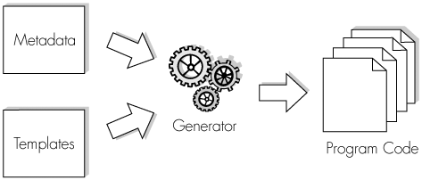
Active code generators typically comprise three different parts: metadata, a pattern template, and the code generator itself:
Metadata.
Metadata is data that describes other data, thereby giving data shape and form. Metadata is available from many sources, including databases, XML schemas, and UML models.
Pattern template.
The pattern template is used by the code generator to render the data described by the metadata in a new form.
Code generator.
The code generator binds the metadata with the pattern template to produce the desired output. The code generator can also embody code generation rules that further define the form of the generated code.

Slide 32
Benefits – Active code
Increased speed.
Improved accuracy.
Better agility.

Slide 33
Alternative Approaches
Automated Reviews:
A review conducted by a computer.
Reduced manual cost of code reviews
Fast, consistent, and repeatable
Removes emotion from the reviews: pride, ego, and ownership need to be constantly recognized when conducting a review
In some cases you have tools that allow for real-time reviews, such as the Eclipse plug-in CodePro Analytix or Resharper for C#. These tools perform an examination of the code as it is being written.

Slide 34
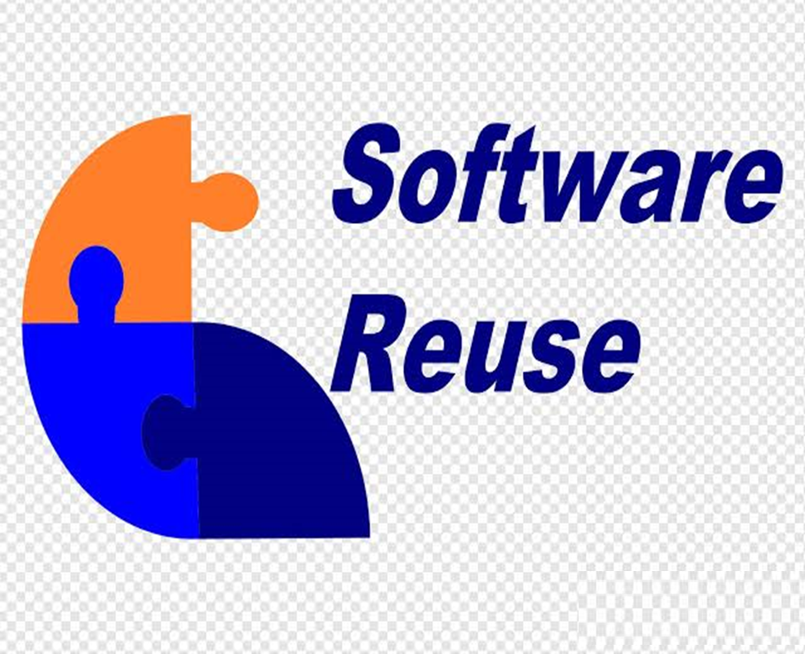

CODE

Slide 35
Code Reuse
Many techniques have evolved to reduce the labor intensive nature of writing source code. Software code reuse is one such technique
Making a block of source code to create a functionality or general utility library and using it at all places in the source code wherever this kind of functionality or utility is required is an example of code reuse.

Slide 36
Code reuse
Code reuse in procedural programming techniques is achieved by creating special functions and utility libraries and using them in the source code.
In OOP - The classes containing functions and data themselves can not only be reused in the same way as functions and libraries, but the classes can also be modified by way of creating child classes and using them in the source code

Slide 37
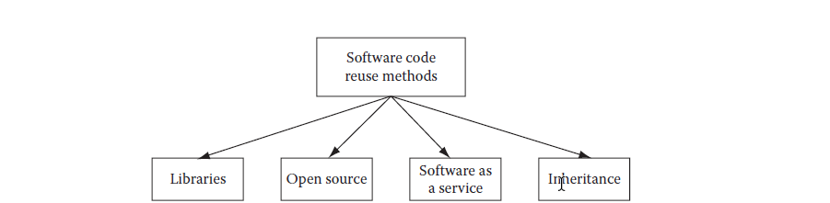
CODE REUSE - METHODS

Slide 38
Software reuse
In most engineering disciplines, systems are designed by composing existing components that have been used in other systems.
Software engineering has been more focused on original development but it is now recognised that to achieve better software, more quickly and at lower cost, we need a design process that is based on systematic software reuse.
There has been a major switch to reuse-based development over the past 10 years.

Slide 39
Reuse-based software engineering
System reuse
Complete systems, which may include several application programs may be reused.
Application reuse
An application may be reused either by incorporating it without change into other or by developing application families.
Component reuse
Components of an application from sub-systems to single objects may be reused.
Object and function reuse
Small-scale software components that implement a single well-defined object or function may be reused.

Slide 40
Benefits of software reuse
Benefit | Explanation
Accelerated development | Bringing a system to market as early as possible is often more important than overall development costs. Reusing software can speed up system production because both development and validation time may be reduced.
Effective use of specialists | Instead of doing the same work over and over again, application specialists can develop reusable software that encapsulates their knowledge.
Increased dependability | Reused software, which has been tried and tested in working systems, should be more dependable than new software. Its design and implementation faults should have been found and fixed.

Slide 41
Benefits of software reuse
Benefit | Explanation
Lower development costs | Development costs are proportional to the size of the software being developed. Reusing software means that fewer lines of code have to be written.
Reduced process risk | The cost of existing software is already known, whereas the costs of development are always a matter of judgment. This is an important factor for project management because it reduces the margin of error in project cost estimation. This is particularly true when relatively large software components such as subsystems are reused.
Standards compliance | Some standards, such as user interface standards, can be implemented as a set of reusable components. For example, if menus in a user interface are implemented using reusable components, all applications present the same menu formats to users. The use of standard user interfaces improves dependability because users make fewer mistakes when presented with a familiar interface.

Slide 42
Problems with reuse
Problem | Explanation
Creating, maintaining, and using a component library | Populating a reusable component library and ensuring the software developers can use this library can be expensive. Development processes have to be adapted to ensure that the library is used.
Finding, understanding, and adapting reusable components | Software components have to be discovered in a library, understood and, sometimes, adapted to work in a new environment. Engineers must be reasonably confident of finding a component in the library before they include a component search as part of their normal development process.
Increased maintenance costs | If the source code of a reused software system or component is not available then maintenance costs may be higher because the reused elements of the system may become increasingly incompatible with system changes.

Slide 43
Problems with reuse
Problem | Explanation
Lack of tool support | Some software tools do not support development with reuse. It may be difficult or impossible to integrate these tools with a component library system. The software process assumed by these tools may not take reuse into account. This is particularly true for tools that support embedded systems engineering, less so for object-oriented development tools.
Not-invented-here syndrome | Some software engineers prefer to rewrite components because they believe they can improve on them. This is partly to do with trust and partly to do with the fact that writing original software is seen as more challenging than reusing other people’s software.

Slide 44
Application system reuse

Slide 45
Application system reuse
An application system product is a software system that can be adapted for different customers without changing the source code of the system.
Application systems have generic features and so can be used/reused in different environments.
Application system products are adapted by using built-in configuration mechanisms that allow the functionality of the system to be tailored to specific customer needs.
For example, in a hospital patient record system, separate input forms and output reports might be defined for different types of patient.

Slide 46
Benefits of application system reuse
As with other types of reuse, more rapid deployment of a reliable system may be possible.
It is possible to see what functionality is provided by the applications and so it is easier to judge whether or not they are likely to be suitable.
Some development risks are avoided by using existing software. However, this approach has its own risks, as I discuss below.
Businesses can focus on their core activity without having to devote a lot of resources to IT systems development.
As operating platforms evolve, technology updates may be simplified as these are the responsibility of the COTS product vendor rather than the customer.

Slide 47
Problems of application system reuse
Requirements usually have to be adapted to reflect the functionality and mode of operation of the COTS product.
The COTS product may be based on assumptions that are practically impossible to change.
Choosing the right COTS system for an enterprise can be a difficult process, especially as many COTS products are not well documented.
There may be a lack of local expertise to support systems development.
The COTS product vendor controls system support and evolution.

Slide 48
COTS-solution and COTS-integrated systems
Configurable application systems | Application system integration
Single product that provides the functionality required by a customer | Several heterogeneous system products are integrated to provide customized functionality
Based around a generic solution and standardized processes | Flexible solutions may be developed for customer processes
Development focus is on system configuration | Development focus is on system integration
System vendor is responsible for maintenance | System owner is responsible for maintenance
System vendor provides the platform for the system | System owner provides the platform for the system

Slide 49
TEST DRIVEN DEVELOPMENT - OVERVIEW

Slide 50
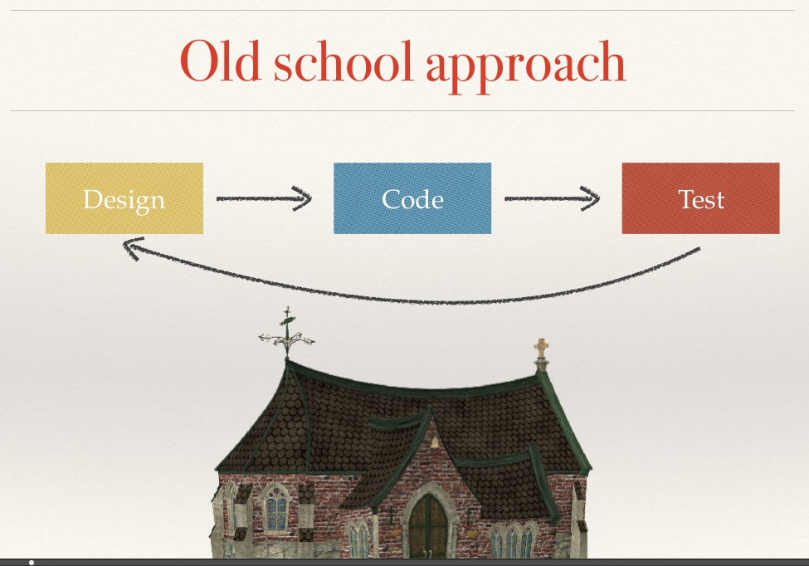

Slide 51
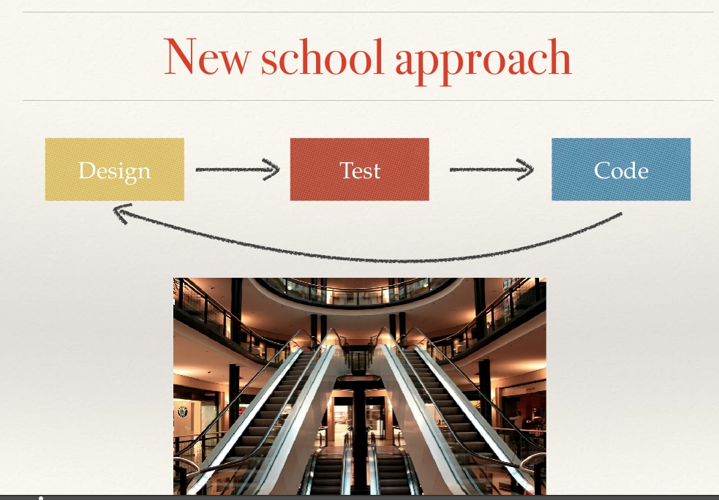

Slide 52
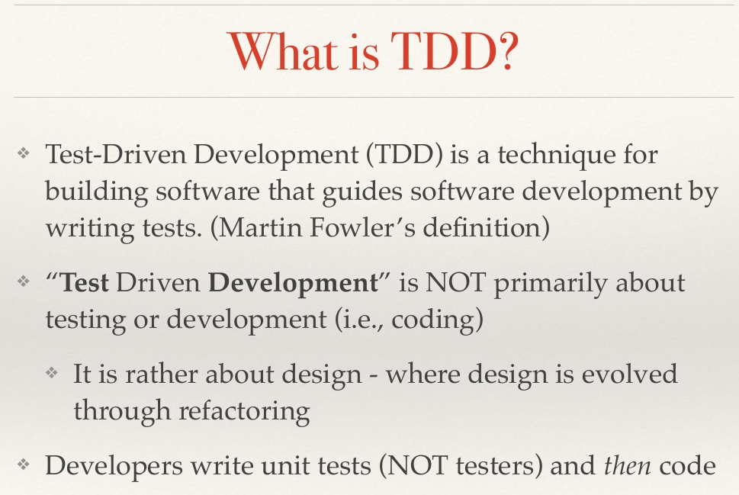

Slide 53
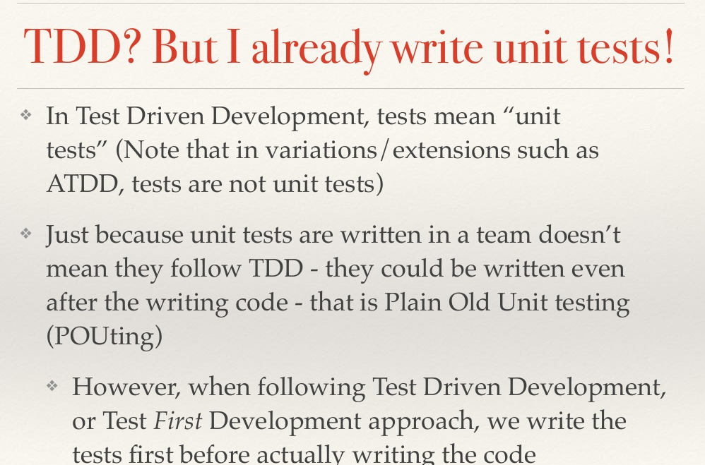

Slide 54
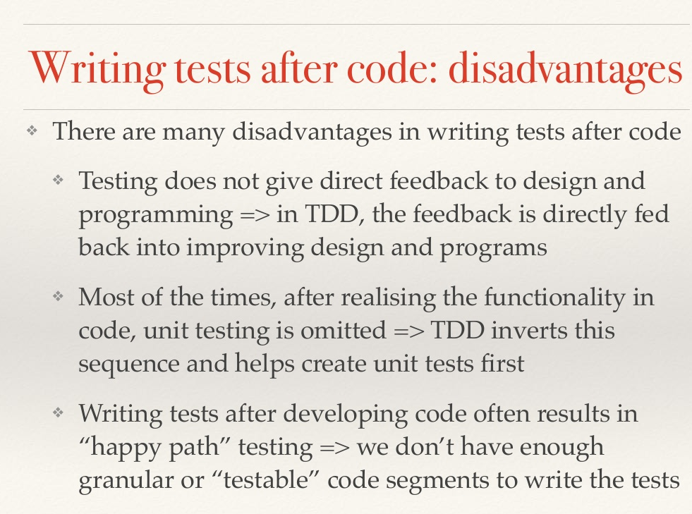

Slide 55
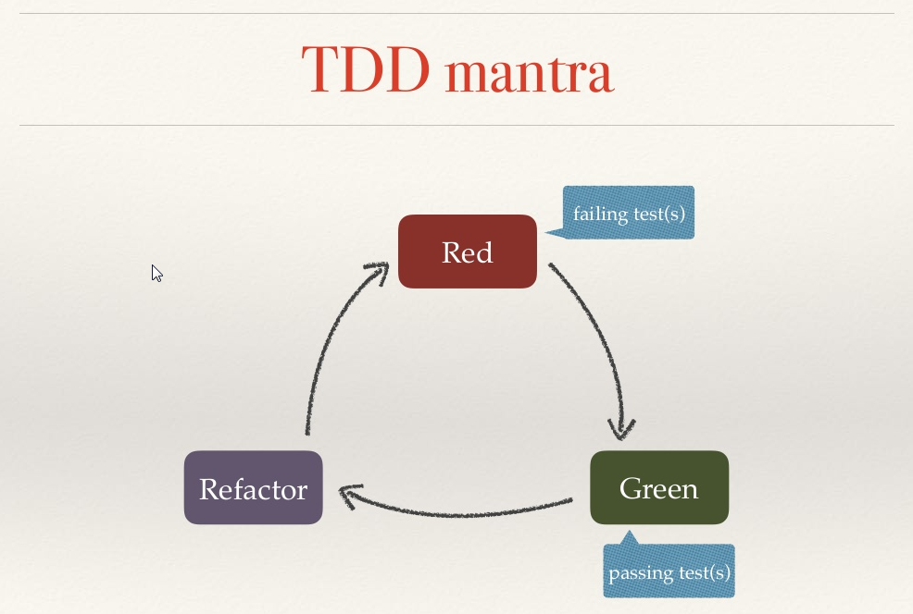

Slide 56
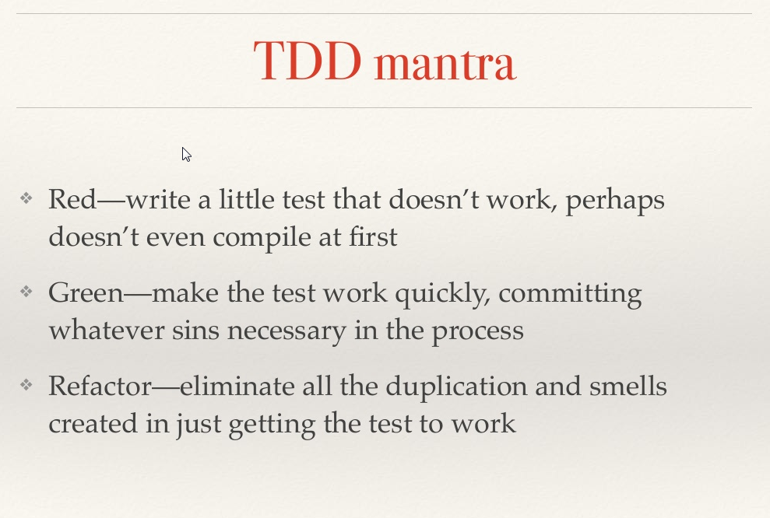

Slide 57
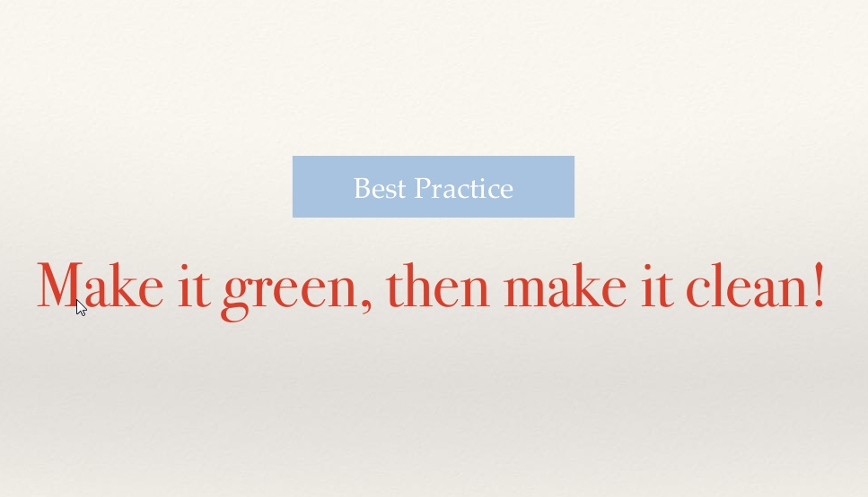

Slide 58
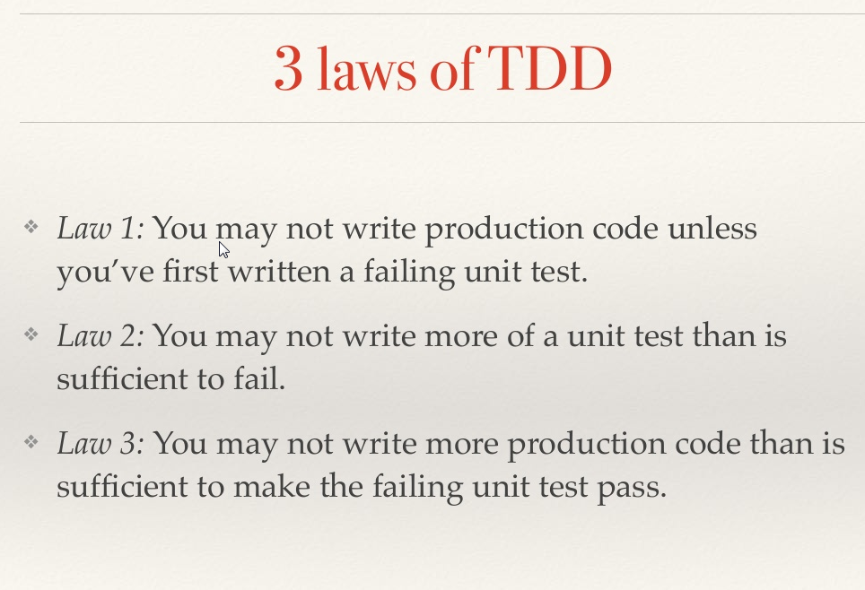

Slide 59
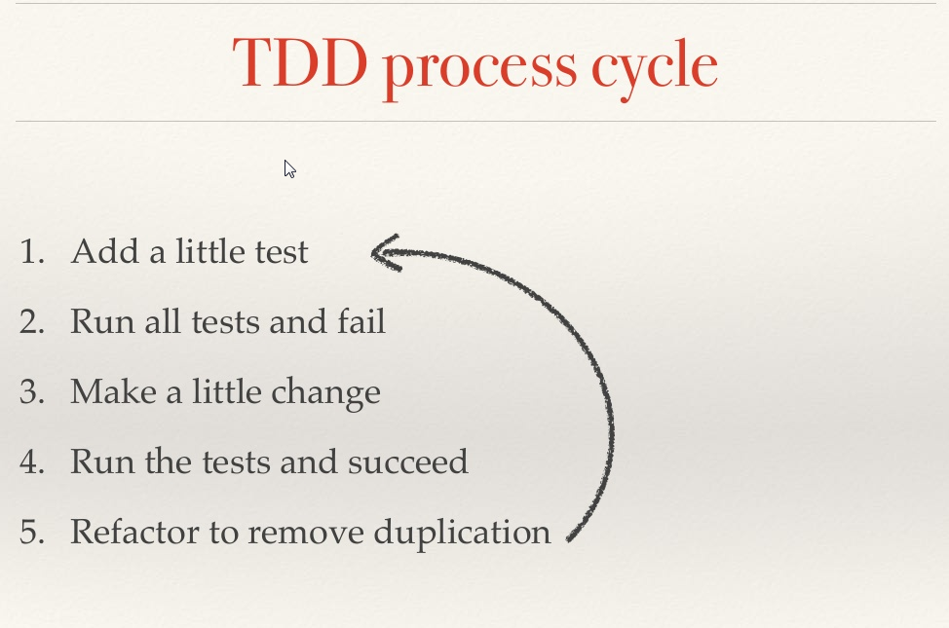

Slide 60
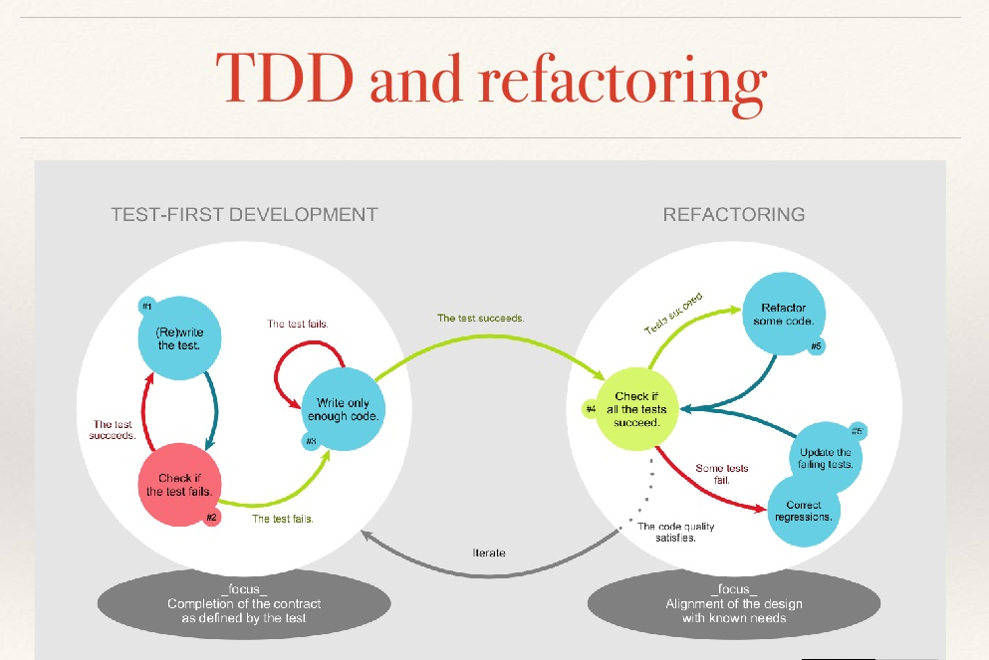

Slide 61
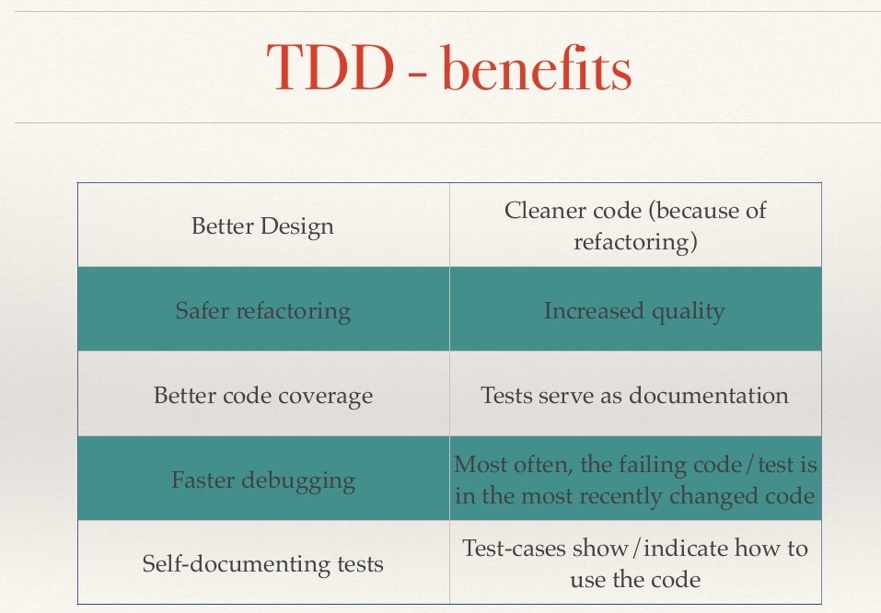

Slide 62
Software Construction Artifact
An artifact is one of many kinds of tangible by-product produced during the development of software.
Some artifacts (e.g., use cases, class diagrams, and other UML models, requirements and design documents) help describe the function, architecture, and design of software.
Other artifacts are concerned with the process of development itself—such as project plans, business cases, and risk assessments.

